Slide 1
Pseudo Classes and Elements
Designing for consistent appearance

Slide 2

Pseudo-Classes
Elements that are dynamically populated or dependent on tree structure
You have seen this before…

Slide 3
Types of Pseudo-Classes
Link
:link, :visited
User Action
:hover, :active, :focus
Forms (interfaces)
:enabled, :checked, :disabled

Slide 4
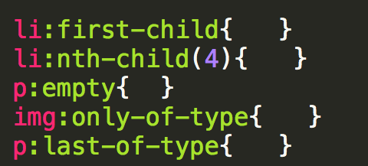
Types of Pseudo-Classes
Structural/Positional
:first-child, :last-child, :nth-child(), :only-child
:first-of-type, :last-of-type, :only-of-type

Slide 5
Example

Slide 6
Pseudo-Elements
These elements aren’t part of the DOM
Can be used to style specific (unique) parts of the page

Slide 7
Types of Pseudo-Elements
Textual
:first-letter, :first-line
Positional/Generated
:before, :after
Fragments
::selection

Slide 8
Example

Slide 9
Review
Pseudo-elements and classes are just one more way to add style to your page
I haven’t covered every combination so make sure to do some investigation on your own

Slide 10

Acknowledgements/Contributions
These slides are Copyright 2015- Colleen van Lent as part of http://www.intro-webdesign.com/ and made available under a Creative Commons Attribution Non-Commercial 4.0 License. Please maintain this last slide in all copies of the document to comply with the attribution requirements of the license. If you make a change, feel free to add your name and organization to the list of contributors on this page as you republish the materials.
Initial Development: Colleen van Lent , University of Michigan School of Information

